Slide 1




Slide 2

TIME MANAGEMENT MONITORING ADHERING TO DEADLINES

Slide 3

PRESENTATION SKILLS
Time management skills
MORE WORK IN LESS TIME WITH LESS EFFORT
Notes:
Time management techniques are a set of rules and principles you need to follow in order to be more productive and efficient with your time, make better and faster decisions, as well as accomplish more in less time and with less effort.
There are plenty of time management techniques based on approved time management best practices:
Writing down what you need to do today
Working on important and urgent tasks first
Saving time for priority tasks, routine tasks, but also breaks
Proper stress management
Proper team management
Tracking project progress and identifying lags
Most time management techniques deal with one or more of the listed points, and you can make the choice for your time management techniques by looking over what you want to improve in your routine.
Apart from that, you'll also need to consider the time management skills you need to improve and your personal time management style. Moreover, you can choose particular time management techniques for work, so that you better organize your workdays, too.

Slide 4
Writing down what you need to do today
Working on important and urgent tasks first
Saving time for priority tasks, routine tasks, but also breaks
Proper stress management
Proper team management
Tracking project progress and identifying lags

Slide 5

PRESENTATION SKILLS
Effective time management skills are

Slide 6

PRESENTATION SKILLS
Setting SMART goals
Notes:
make sure the goals you set for yourself are Specific, Measurable, Attainable, Relevant, and Time-bound.

Slide 7

PRESENTATION SKILLS
Effective planning
Notes:
make sure you have clear objectives, as well as defined tasks and resources in order to make a clear plan that will lead you to your goals.

Slide 8

PRESENTATION SKILLS
Stress management
Notes:
make sure you manage your stress with stress relieving strategies and tactics, in order to feel more relaxed while doing your work.

Slide 9

PRESENTATION SKILLS
Proper task delegation
Notes:
delegating tasks helps you ease the workload and share it with competent colleagues and employees.

Slide 10

PRESENTATION SKILLS
Avoiding distractions
Notes:
distractions take away from the time you should be working (or even relaxing), so you should learn how to avoid them.

Slide 11
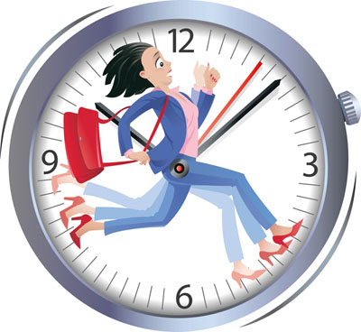
PRESENTATION SKILLS
Single-tasking
Notes:
Single-tasking — focusing on one task at a time helps you deliver quality end results much better than when you multitask.

Slide 12
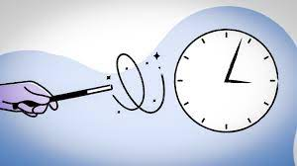
PRESENTATION SKILLS
Saying "No"
Notes:
this little two-letter word will help you save more time for your own priorities.

Slide 13

PRESENTATION SKILLS
Setting priorities
Notes:
Investing time into the right tasks will ask for less effort, but bring better results. This is also known as the 20/80 rule, or the Pareto principle.

Slide 14
20-80-Pareto principle
20 percent of your efforts IN THE RIGHT PLACE produce 80 percent of the results.
80% of the effects come from 20% of the causes
20% of your workforce is responsible for 80% of the output
80% of your success comes from 20% of your ideas.
80% of the public uses 20% of their computers' features.
80% of crimes are committed by 20% of criminals.
80% of sales are from 20% of clients

Slide 15

PRESENTATION SKILLS
Beating procrastination
Notes:
Identify the causes of your procrastination and tackle them.

Slide 16

PRESENTATION SKILLS
Follow the Pareto principle
you do less, but achieve more, which saves you time.
Moreover, it brings a boost to your confidence — you’re not trying too hard, but you’re still successful.
Notes:
According to Italian economist Vilfredo Pareto and his Pareto principle, 80% of all problems result from 20% of all the causes.
More precisely, the Pareto definition states that investing 20% of your efforts in the right place will help you achieve as much as 80% of your desired results.
Here are some Pareto Principle examples, to help illustrate how it all works:
80% of problems in your program come from 20% of all the currently reported bugs
80% of all your sales come from 20% of your products
80% of all your customers only use 20% of your app’s features
In essence, you do less, but achieve more, which saves you time.
Moreover, it brings a boost to your confidence — you’re not trying too hard, but you’re still successful.

Slide 17

PRESENTATION SKILLS
How to follow the Pareto principle
Notes:
The use of the Pareto principle in time management is simple — you can work on select tasks first to do less but achieve a greater, more noticeable effect.
If we take the above-mentioned examples into account and make them more concrete, here’s how the Pareto principle works:
80% of problems in your program come from 20% of all the currently reported bugs. If you have 10 bugs and solve the right 2, you’ll up your program’s performance by 80%.
80% of all your sales come from 20% of your products. It’s best that you don’t expand your manufacture to 20 different products, but instead focus on perfecting the 4 that sell the best.
80% of all your customers only use 20% of your app’s features. Similar to the example above, you should focus first on streamlining your most popular features, and then consider expanding your functionalities.

Slide 18

PRESENTATION SKILLS
Time Management for Meeting Deadlines

Slide 19

PRESENTATION SKILLS
Set Goals
Small goals and large goals
Notes:
Make a list of your goals for the week. Write down any goal you wish to achieve, whether it’s work-related or not. Then organize your work-related goals into large and small goals. For example, “looking up information for an article” is a small goal, while “writing the final draft of the article” is a big goal. “Figuring out the topic for a PowerPoint presentation” is a small goal. “Creating the PowerPoint” is a large goal. Basically, large goals will take up more of your time. Next, put an average time for completion next to each goal. This will help you organize your week.

Slide 20

PRESENTATION SKILLS
Put Together a Checklist
YoYou will get a positive feeeling of accomplishing your goals
Notes:
Create a daily checklist so you can cross off the goals you’ve accomplished. A checklist will help with work management and make you more productive. It will also feel good to cross off the goals you’ve achieved for the day, no matter how small. And that positive feeling will help you continue to work toward completing all of your goals.

Slide 21

PRESENTATION SKILLS
Set Aside Uninterrupted Time

Slide 22

PRESENTATION SKILLS
Prioritize
Notes:
Remember to prioritize your goals. Larger goals that have to get done sooner are the ones you should be working on first. Sometimes people put off larger goals because they’re too intimidating. But the more you put them off, the more intimidating they’ll be. Try and break down your larger goals into three or more smaller goals and work on them consecutively. Psychologically, you’ll feel less stressed trying to complete three smaller goals versus one large goal.

Slide 23

PRESENTATION SKILLS
Prioritize wisely
Notes:
When you have several tasks to do, but don’t know where to start, there’s only one thing you can do to make your time pay off the most — single out your priorities and make plans.
Planning and prioritizing involve deciding whether a task is important or not, and urgent or not. Naturally, you’ll work on important and urgent tasks first, and work your way down from there.

Slide 24
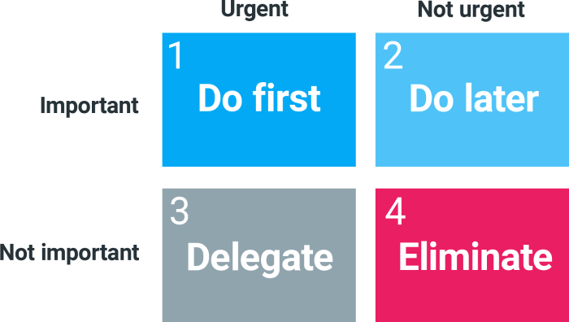
PRESENTATION SKILLS
How to prioritize wisely
Notes:
There are 2 main ways for you can handle your prioritization — The Eisenhower Matrix and the “Eat that Frog” time management technique:
Prioritize via the Eisenhower Matrix
The Eisenhower Matrix is a prioritization technique that works on the following principle.
First, you divide your tasks into 4 quadrants
The 1st quadrant (important and urgent tasks) — these tasks are your top priority and should be handled immediately.
The 2nd quadrant ( important, but not urgent tasks) — these tasks are important enough to be tackled next, but not urgent enough so that you make them your top priority.
The 3rd quadrant ( urgent, but not important tasks)—they should be handled immediately, but as they’re not important, you should delegate them to colleagues.
The 4th quadrant (neither important nor urgent tasks) — you should eliminate them from your to-do list.
Prioritize by “Eating that frog”
Eat that frog is a prioritization technique that works on the following principle.
You mark your tasks with letters of the alphabet that indicate their importance and urgency:
“A” — your “frog”, or your most important task, the one you should tackle first
“B” — second most important task, less important than “A”, but still vital
“C” — a task you can do, but it’s not crucial if you don’t have the time
“D” — urgent, but less important tasks, ones you should delegate
“E” — tasks you can eliminate, as they’re neither important nor urgent
As you can see, both listed prioritization techniques follow the same principle — you prioritize based on the level of urgency and importance, and single out your priorities.

Slide 25

PRESENTATION SKILLS
Make Small Changes
Notes:
If completely reorganizing your day sounds too daunting, try and make a couple of small changes every few days. If you’re prone to skipping lunch, make sure you schedule a lunch break into your day. You won’t get as much accomplished if you’re hungry or worn out. Even a couple of 15-minute breaks away from your desk during the day will help you focus more and stay on target.

Slide 26

PRESENTATION SKILLS
Know Your Productive Period
Notes:
People have different periods during the day when they’re most productive. Some are more productive in the morning, others in the afternoon. Find out when your most productive time of the day is and schedule your most important goals then. This will help you stay more focused and on task. This will also help you accomplish your most important goals in a timely fashion. When you’re not as productive, do a couple of small tasks, look at your emails, or catch up on some research. This will help you work when you’re feeling less productive. Using your natural productivity periods to your advantage will help you feel less stressed and ensure that you get the most out of your workdays.

Slide 27
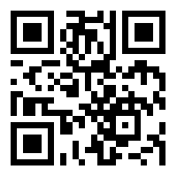
https://learn.codemithra.com

Slide 28




THANK YOU
+91 78150 95095
codemithra@ethnus.com
www.codemithra.com

